Slide 1



Data
Analytics

Slide 2


Today's agenda
Project recap
Problem
The Analytics team
Process
Insights
Summary

Slide 3

Social Buzz is a fast growing technology unicorn
That need to adapt to its global scale.
Accenture has begun a 3 month POC focusing on these tasks :
Project Recap
An audit of Social Buzz’s big Data Practice
Recommendation of successful IPO
Analysis to find Social Buzz’s top 5 most popular categories of content.

Slide 4

Problem
Over 100000 Posts per day
36,500,000 pieces of content per year
Analysis to find Social Buzz’s top 5 most popular categories of
content

Slide 5



Andrew Fleming
Chief Technical Architect
The Analytics team
Marcus Rompton
Senior Principle
Jaideep Singh Dhunna
Data Analyst

Slide 6
Process
1
DATA UNDERSTANDING
2
DATA CLEANING
3
DATA MODELLING
4
DATA ANALYSIS
5
UNCOVER INSIGHTS

Slide 7

Insights
Categories With
Highest Score
Animals
Month with
Most Post
Unique
Categories
16
75K
MAY

Slide 8
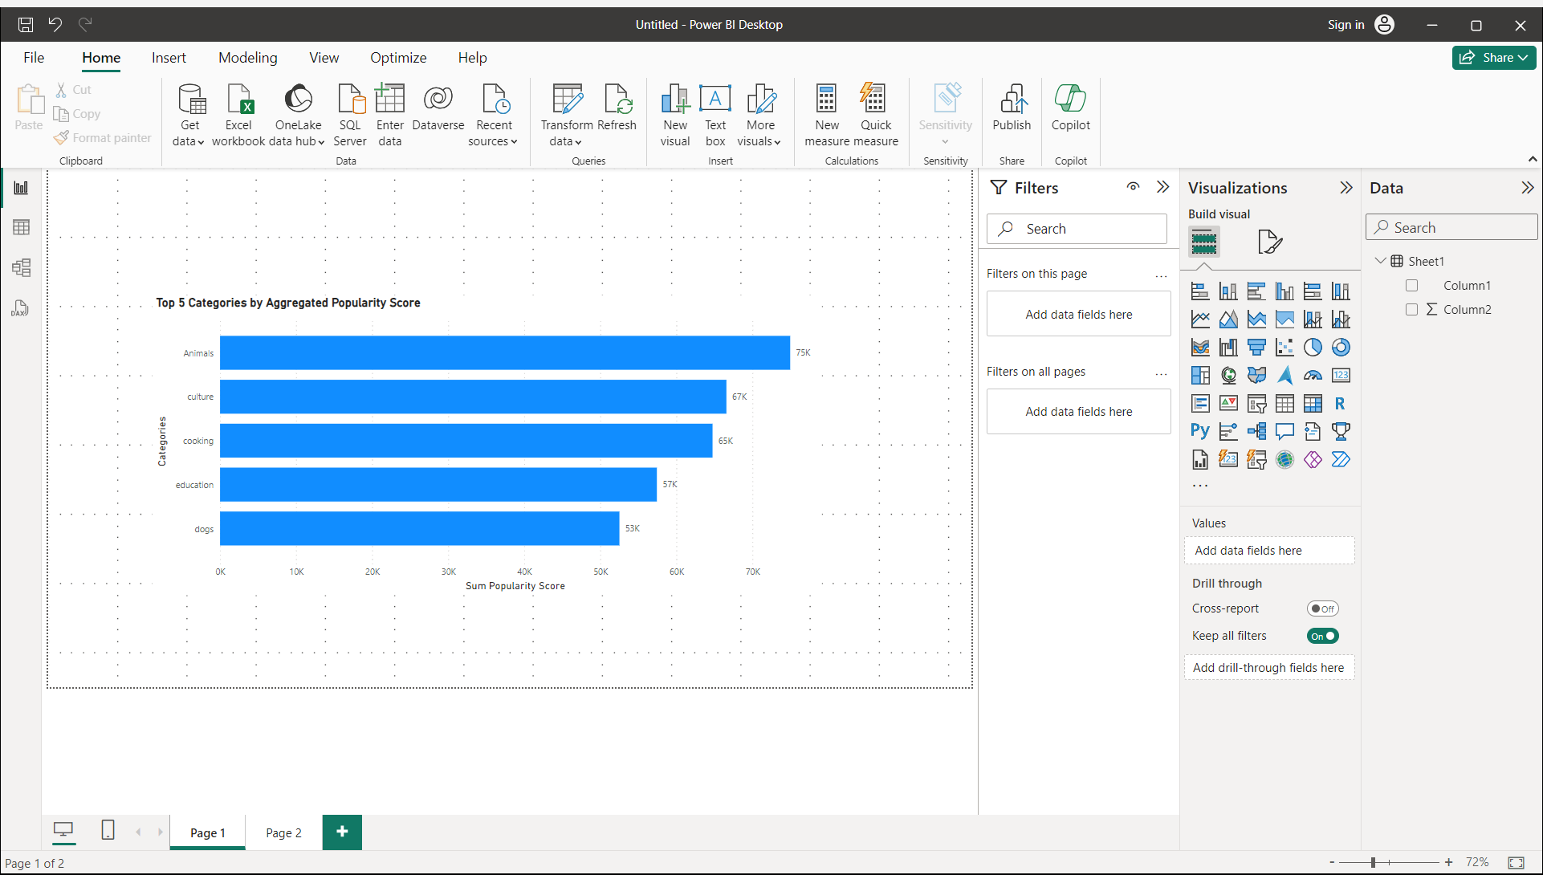

Slide 9
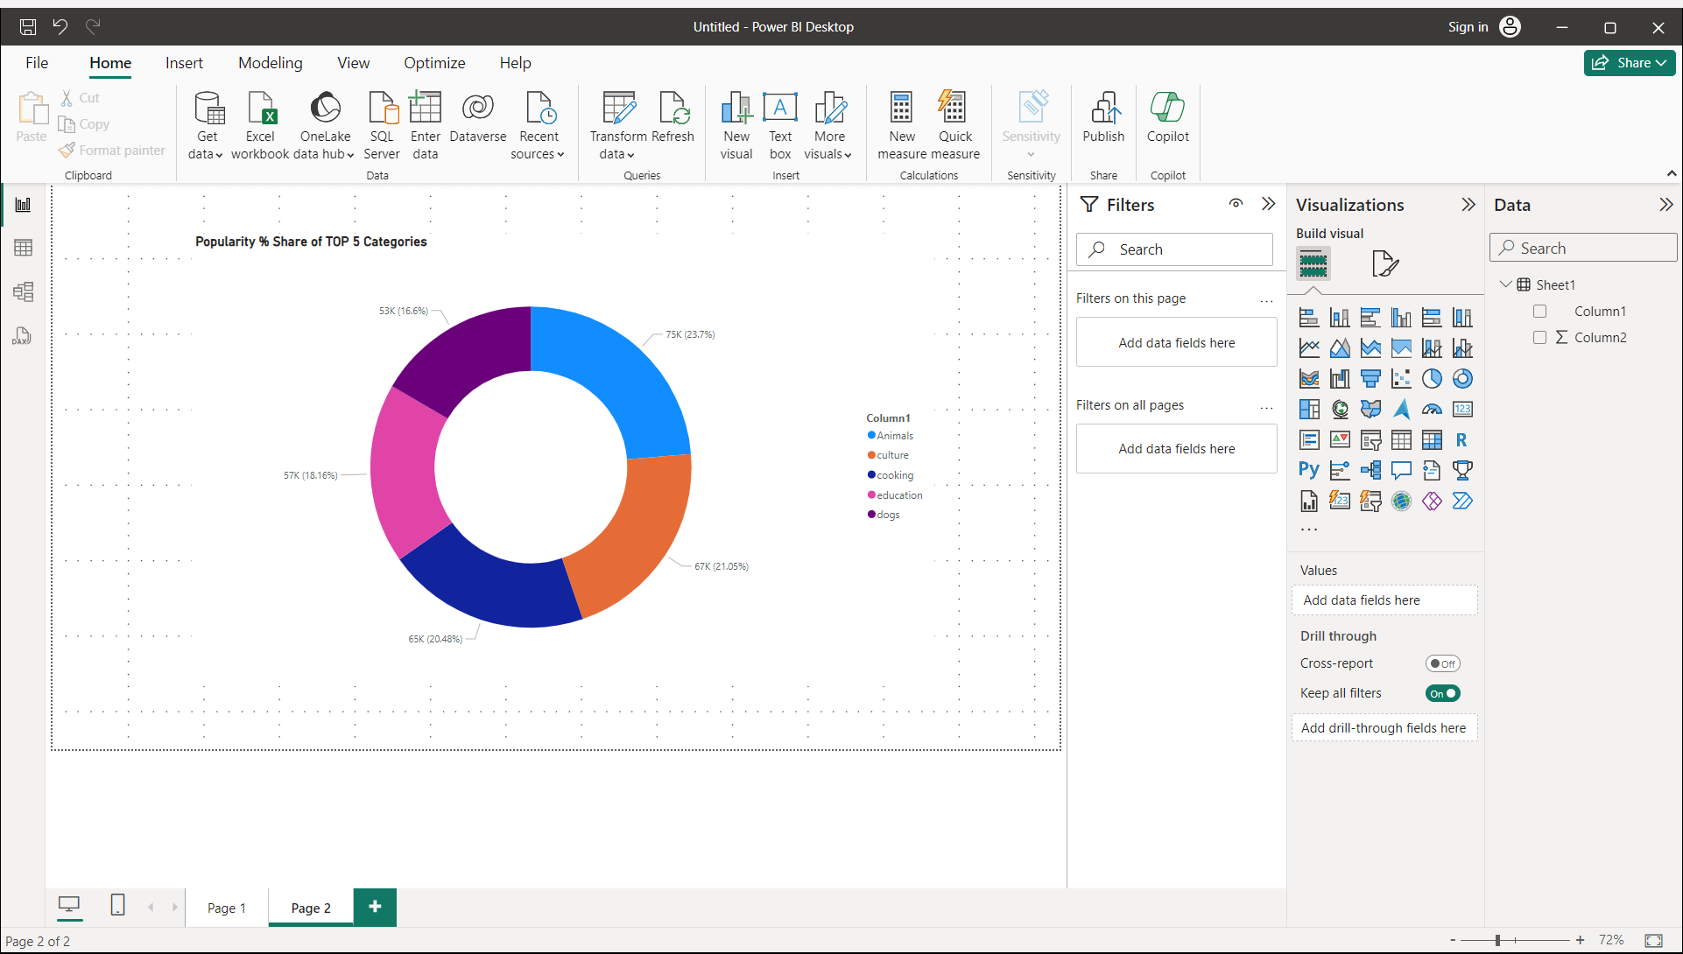

Slide 10

ANALYSIS
Animals and Science are two of the most popular content categories , this shows that people are more interested in real-life and factual content the most
INSIGHT
Summary
Food is a common theme with the top 5 categories with “Healthy Eating” ranking as one of the highest . We can use this insight to start a campaign and work with healthy eating brands
NEXT STEPS
Technological content is among the top categories .it indicates that
Users like technological material. Working with some big digital companies will undoubtedly increases user engagement

Slide 11
Thank you!
ANY QUESTIONS?

